Slide 1


SAP Full-Stack Developer training
ABAP on HANA, UI5 & Fiori, Analytics with OData
Anubhav Oberoy
Day – 6

Slide 2

Agenda – Day 6
ADT ( ABAP Development Tool )
Installation & Setup of ADT on Eclipse
Introduction to OData Services
OData basics
Format of an OData URL
Client Side Query With Odata
--Break--
Deployment Options
EPM Data model
ABAP SEGW Class
Creating OData Service
Building GetEntitySet Method
Building GetEntity(Single Record) Method
Building CreateEntity(POST) Method
Testing the Create Method at Sap Gateway client
Implementing the delete and update method
Function Import

Slide 3

ADT ( ABAP Development Tool )
FREE and open source
Work with multiple systems parallelly
Fully customizable dev environment
It has integration with SAPGUI Ctrl+6
Fast Search and navigation
Ctrl+Shift+A – Search any object
Ctrl + T – Base classes
Integration with Transport Org, ATC
ABAP Profiles
This is the future of ABAP development on HANA and S/4HANA and even ABAP on Cloud
Verity of development using single tool – ABAP, UI5, HANA Native, Java, NodeJS, Android
Quick fix
Design time check on syntax
Code completion Ctrl+Space
Pretty Printer Ctrl+Shift+F
Code templates
Increases developer efficiency

Slide 4
Installation & Setup of ADT on Eclipse
01
Go to link
02
Install Java = java –version to check if its already there Java 8: SAP JVM 8 , Java 11: SapMachine 11
03
VS Runtime - For Windows OS: Microsoft Visual C++ 2013 (x64)
Steps for
Installation of ADT ………..ABAP Development Tool
04
Get an installation of Eclipse 2020-09
(e.g. Eclipse IDE for Java Developers)
05
In Eclipse, choose in the menu bar Help > Install New Software...
06
Enter the URL
https://tools.hana.ondemand.com/2019-09
07
Select ABAP Development Tools and choose Next.
08
On the next wizard page, you get an overview
of the features to be installed. Choose Next.
09
Confirm the license agreements and
choose Finish to start the installation.

Slide 5

Introduction to OData Services
OData is open data protocol, it is used to create REST based services, initially developed by the OASIS company later acquired by Microsoft and make open source.
REST – Representational State Transfer – also known as STATELESS Communication
OData was developed by Microsoft in 2007 and later they made it open source.
Presentation
Fiori
SAP_UI
http request
response
OData
Software Innovation
Hardware Innovation
Hana
Note: Fiori Only and Only Understand OData.

Slide 6
OData Basic
When we call a service, it loads a service document, a service document includes multiple OData Entity Sets inside. Each service also has a metadata document which explains about properties inside of each entity set.
Service Document (Collection of Entity Sets) – 1 Entity Set = 1 DB Table
https://services.odata.org/V2/(S(gte5obp1xr5gdvcqffzwbrwq))/OData/OData.svc/
Service metadata (/$metadata) – all the entity types and entity sets
Entity Type is the blue print of data set, entity set is the access point of actual data
https://services.odata.org/V2/(S(gte5obp1xr5gdvcqffzwbrwq))/OData/OData.svc/$metadata
Access Multiple Records of an Entity Set (SELECT * FROM dB table)
https://services.odata.org/V2/(S(gte5obp1xr5gdvcqffzwbrwq))/OData/OData.svc/Products?$format=json

Slide 7
Format of an OData URL
http(s)://hostname:port/sap/opu/odata/sap/SERVICENAME_SRV/ENTITYSET?p1=val&p2=val
Protocol
Adress & Port
Path prefix
Service Name
End Point Access Data
Query Options

Slide 8
Client Side Query with OData
Sets the page size of results.
02
$top
Indexes into a result set. Also used by some APIs to implement paging and can be used together with $top to manually page results.
Returns the results in the specified media format.
01
03
$format
$skip
ODATA Query
06
04
Retrieves related resources.
Filters properties (columns).
$expand
$select
05
$filter
Filters results (rows).

Slide 9

Break

Slide 10
Deployment options
Presentation
Option 1: Fiori Central HUB Deployment
Advantage
Able to use Fiori – adapt innovation
We are able to connect now multiple such backend
Separation of duties
More security
Upgrade free
Disadvantage
Cost
Confusion
Manage security double
Functionality is distributed
Redundancy
Latency
SAP Netweaver 7.4
Fiori Frontend System – FES
Gateway system
Fiori
SAP_UI
RFC – SM59
SAP ERP(Application Layer)
Existing functionality and data
Backend -- BES
SAP CRM
SAP SRM
Database
Database
Database

Slide 11
Deployment options
Presentation
Option 2: Embedded Deployment
Advantage
Low Cost
Confusion is gone
No need to create RFC – LOCAL
Setup is much easier
Security is at one place
Low latency
Still use this system as a HUB in future
Disadvantage
We must be on SAP Netweaver 7.4
If the system is down, both fiori and classical functionality will not work.
Fiori
SAP_UI
RFC – SM59
SAP ERP(Application Layer)
Existing functionality and data
Database
SAP_UI and SAP_GWFND
https://www.sap.com/documents/2018/02/f0148939-f27c-0010-82c7-eda71af511fa.html

Slide 12
EPM Data Model
Enterprise Procurement Model – Products, Business Partner (Suppliers and Customers), Orders and Order Items.
BAPIs = Function Modules which are reusable and can be called from another systems as well
BAPI_EPM*
BAPI_EPM_PRODUCT_GET_LIST – All the list of products in the system
BAPI_EPM_PRODUCT_GET_DETAIL – details of a single product
BAPI_EPM_PRODUCT_CREATE – create a new product
BAPI_EPM_PRODUCT_UPDATE – update existing product
BAPI_EPM_PRODUCT_DELETE – delete the product
Business partners (BP)
BAPI_EPM_BP_GET_LIST
BAPI_EPM_BP_GET_DETAIL
BAPI_EPM_BP_CREATE
BAPI_EPM_BP_UPDATE
BAPI_EPM_BP_DELETE
CRUD
Create
Read
Update
Delete

Slide 13
TCode
SEGW – Service Builder
/N/IWFND/MAINT_SERVICE – Registration of services
/N/IWFND/ERROR_LOG – Error logs of service calls
/N/IWFND/GW_CLIENT – test services locally within sap system
ABAP SEGW CLASSES
It has the code which provides the metadata
SAP Generated
It has the code which provides the actual data in the output when EntitySet is called
Runtime Artifacts
MPC
(Model provider Class)
DPC
(Data Provider Class)
MPC_EXT (Extension)
Code which developer will write
DPC_EXT (Extension)
All the ABAP Code which works with CRUD implementations

Slide 14
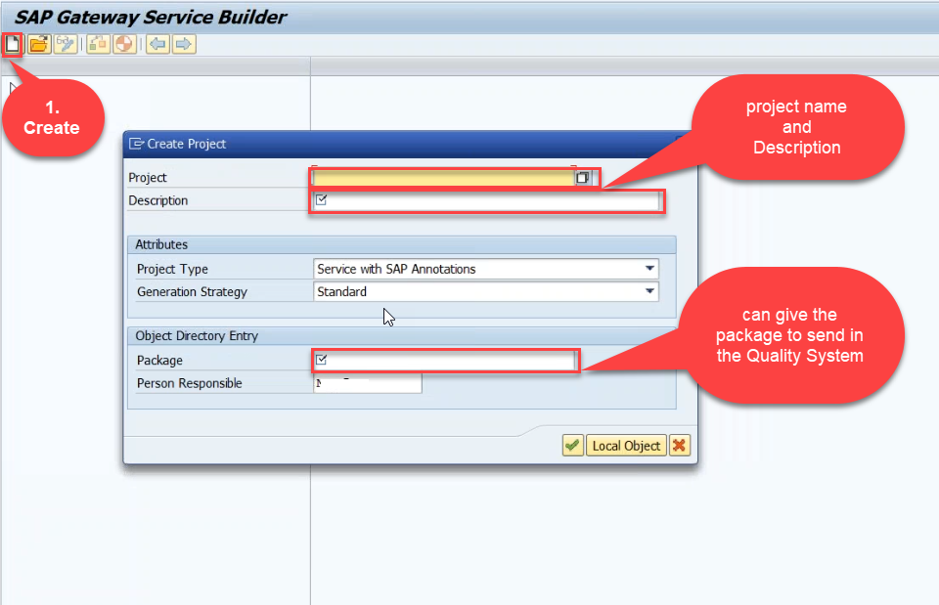
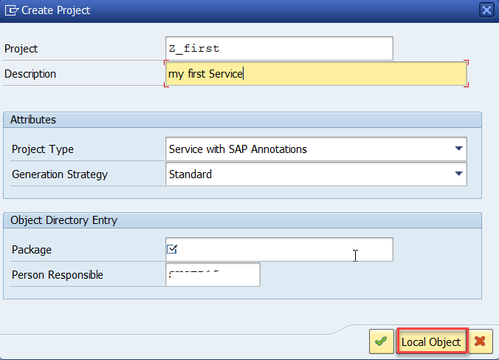
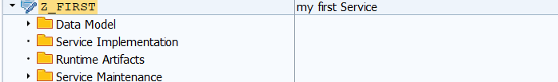
Creating OData Service
Step1: Strat your SAP LOGON, and to Sap Gateway Service Builder(SEGW) and click on Create

Slide 15
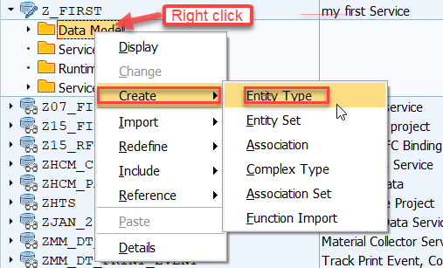
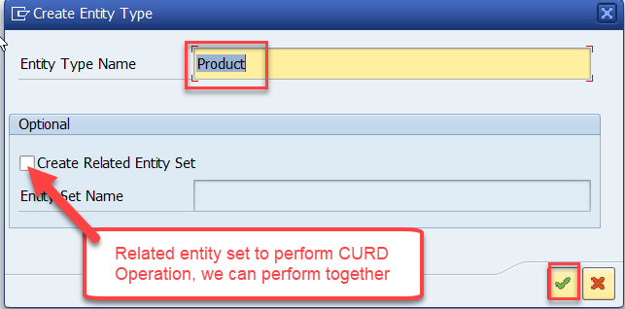
Creating OData Service
Step2: Defining the Data Model (Blue print of data)

Slide 16
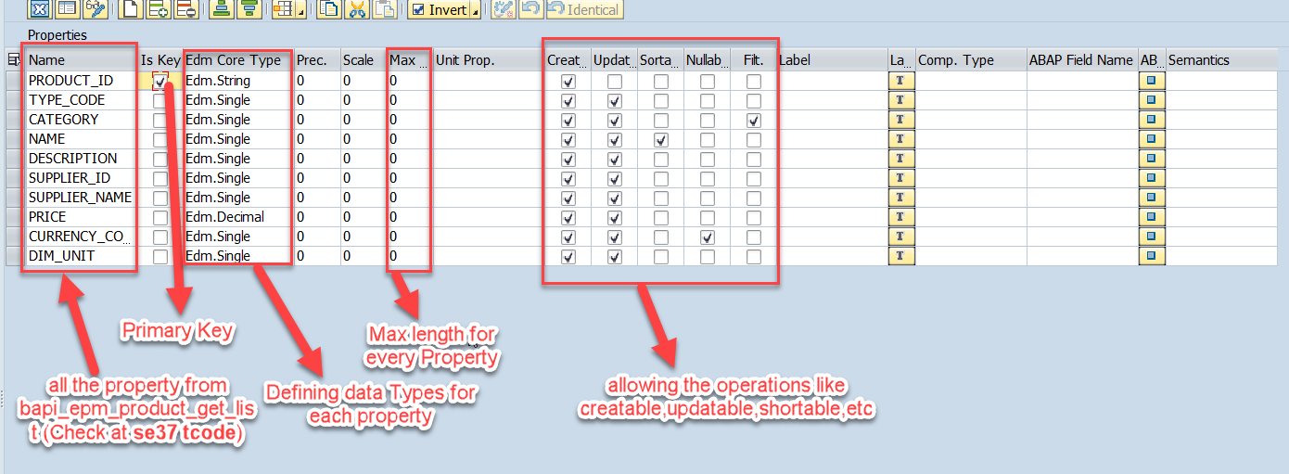
Creating OData Service
Step3: Creating Properties for data model (from bapi_epm_product_get_list (tcode- se37))

Slide 17
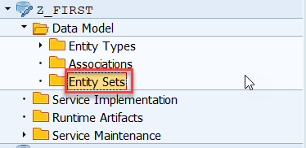
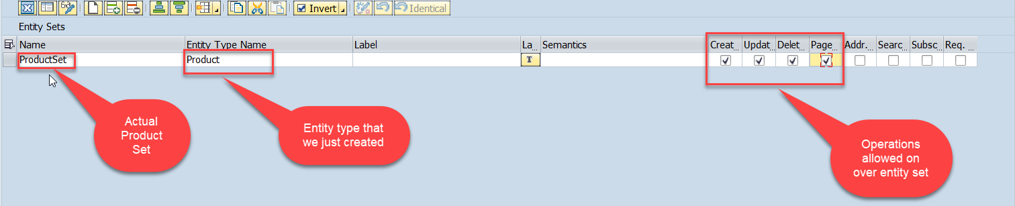
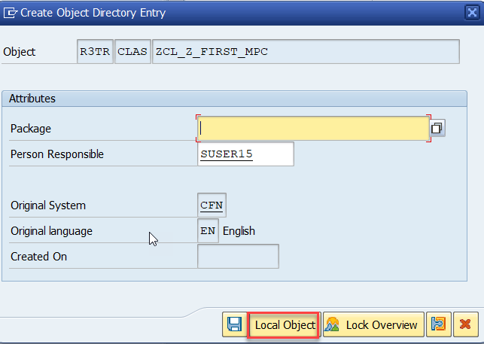
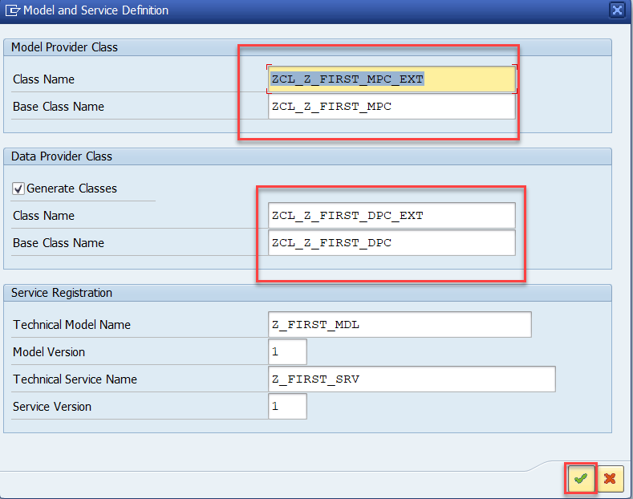
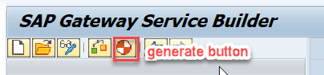
Creating OData Service
Step4: Creating entity set to perform actual CURD operations and service generation

Slide 18
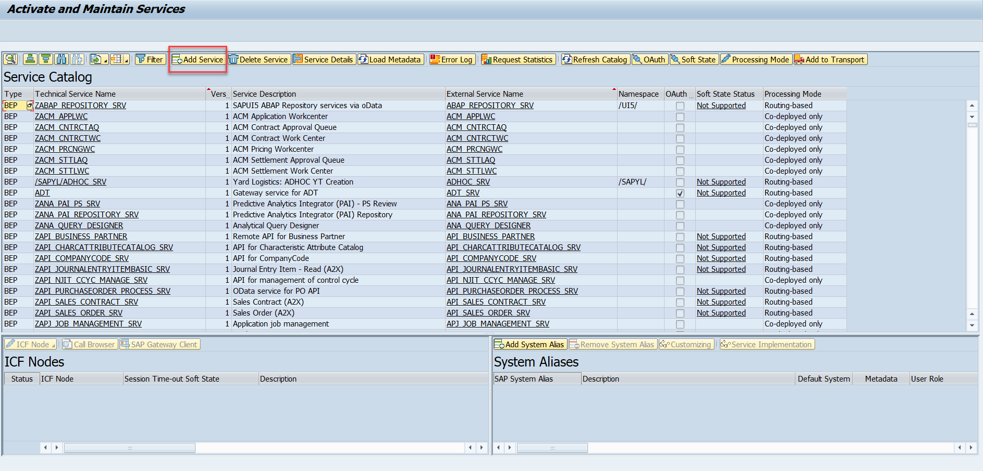
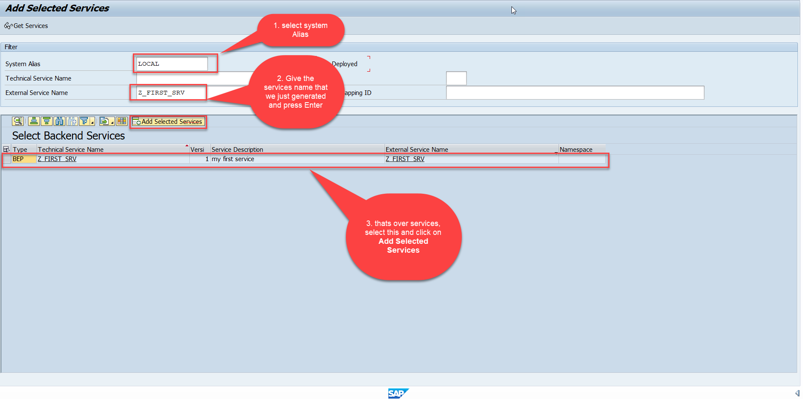
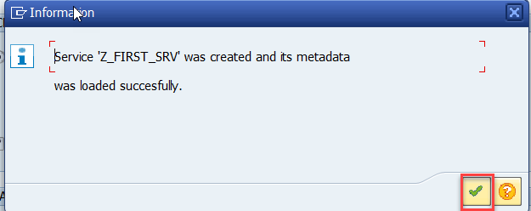
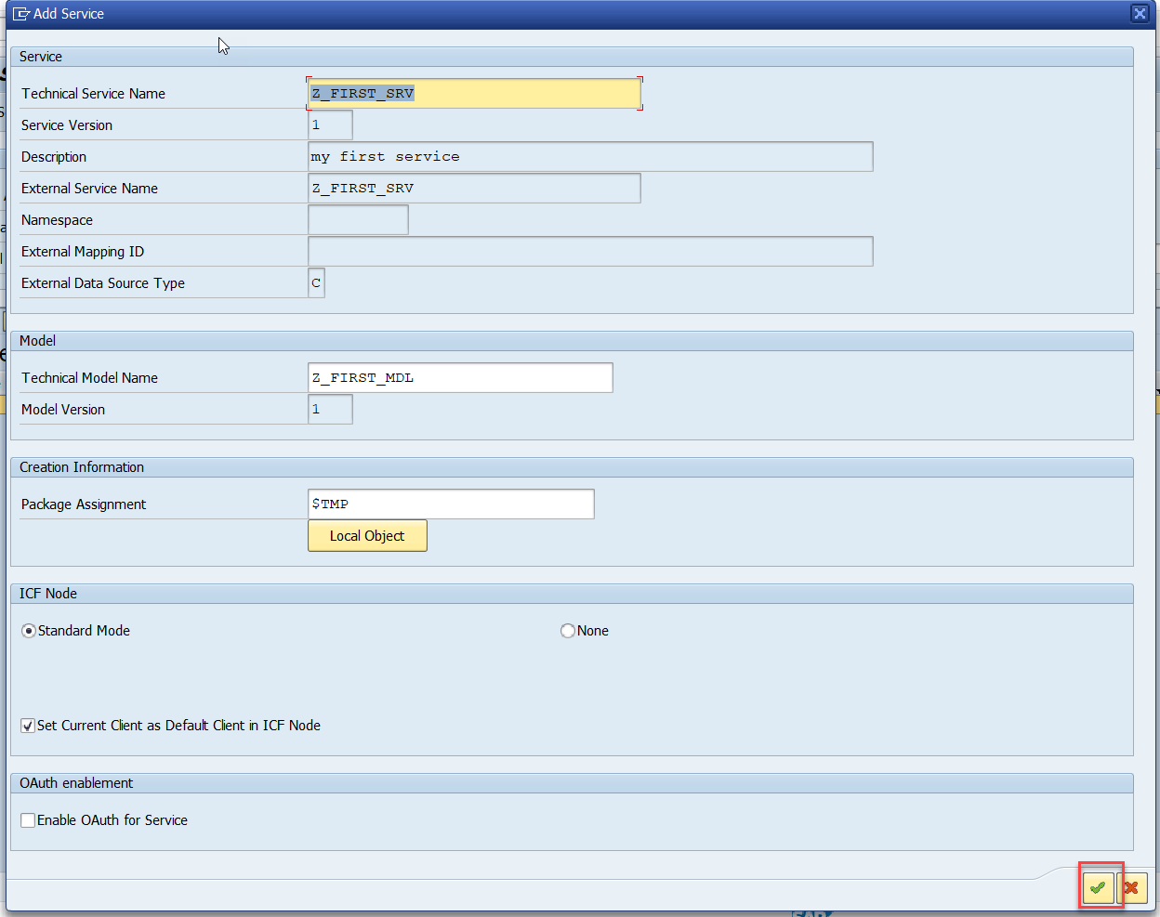
Creating OData Service
Step5: Service Registration (Go to tcode- /iwfnd/maint_service)

Slide 19
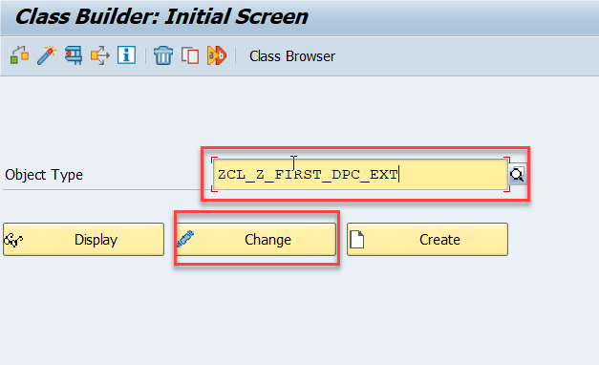
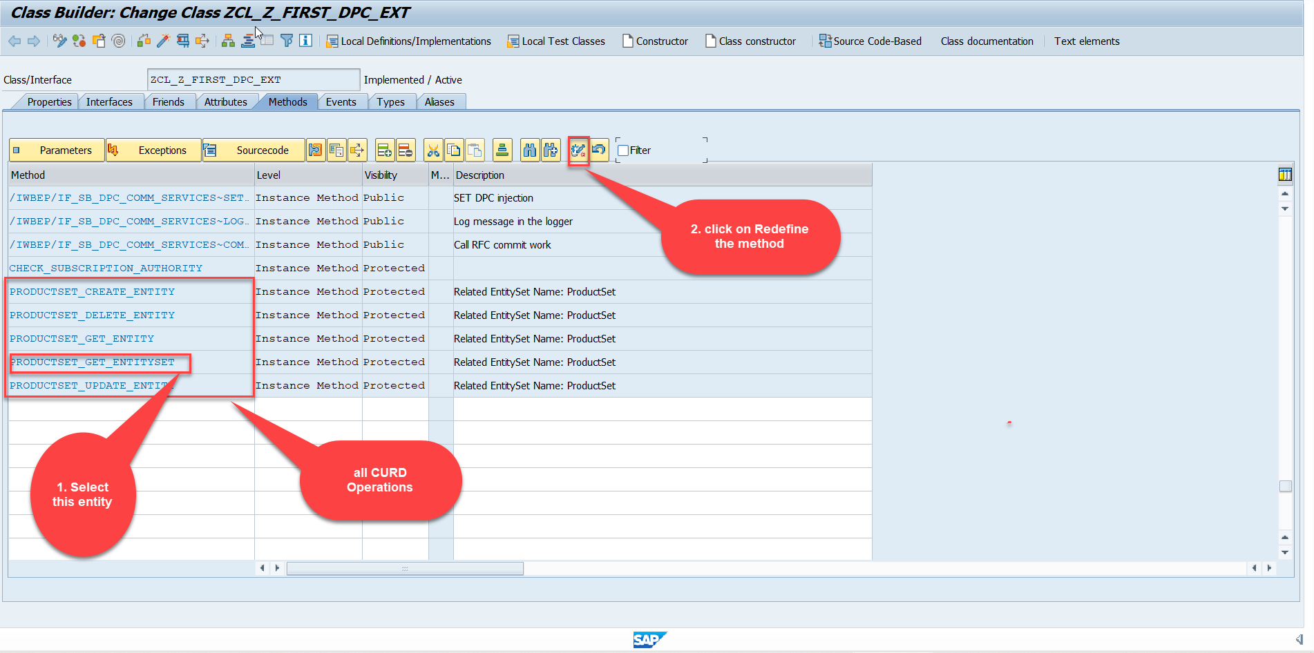
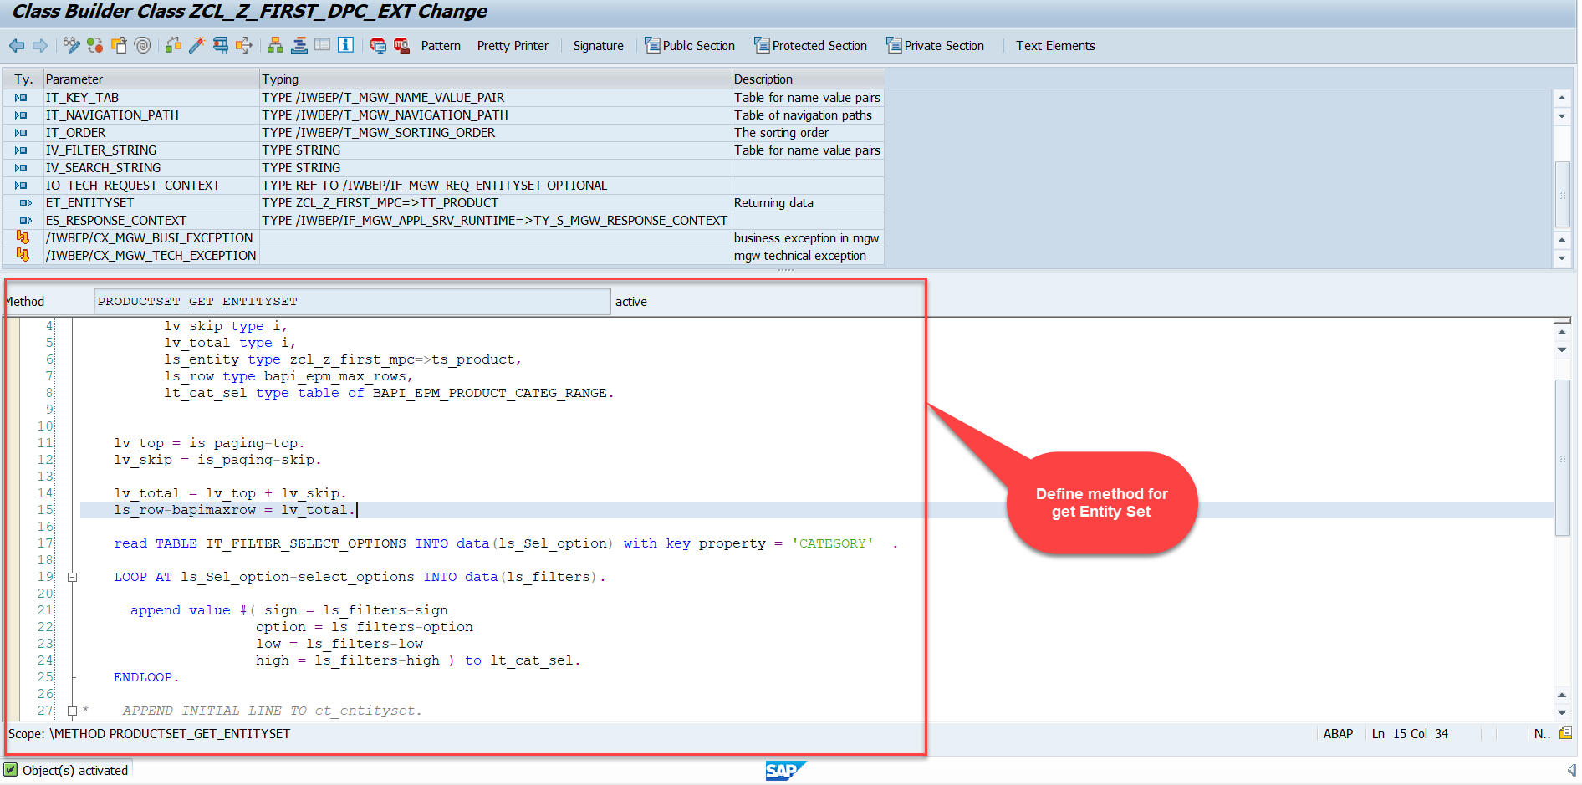
Building GetEntitySet Method
Step1: ProductSet Get Entity method(with filter, top and skip) in DPC Extension (Class Builder tcode- se24)
Note: Click on the image to get Complete code.

Slide 20
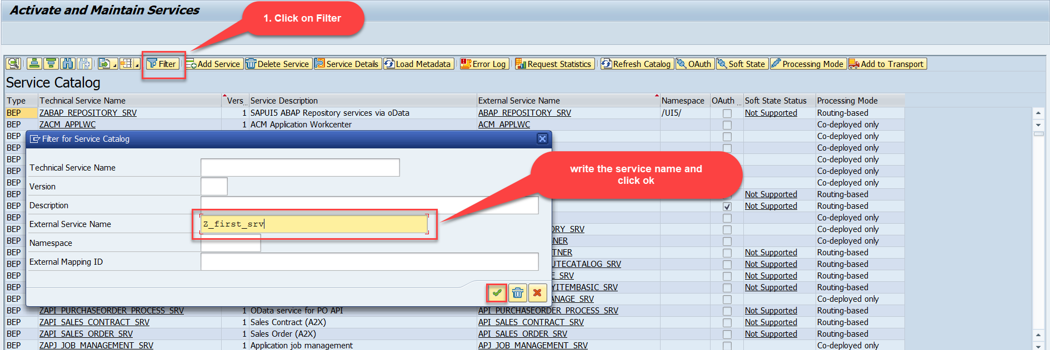
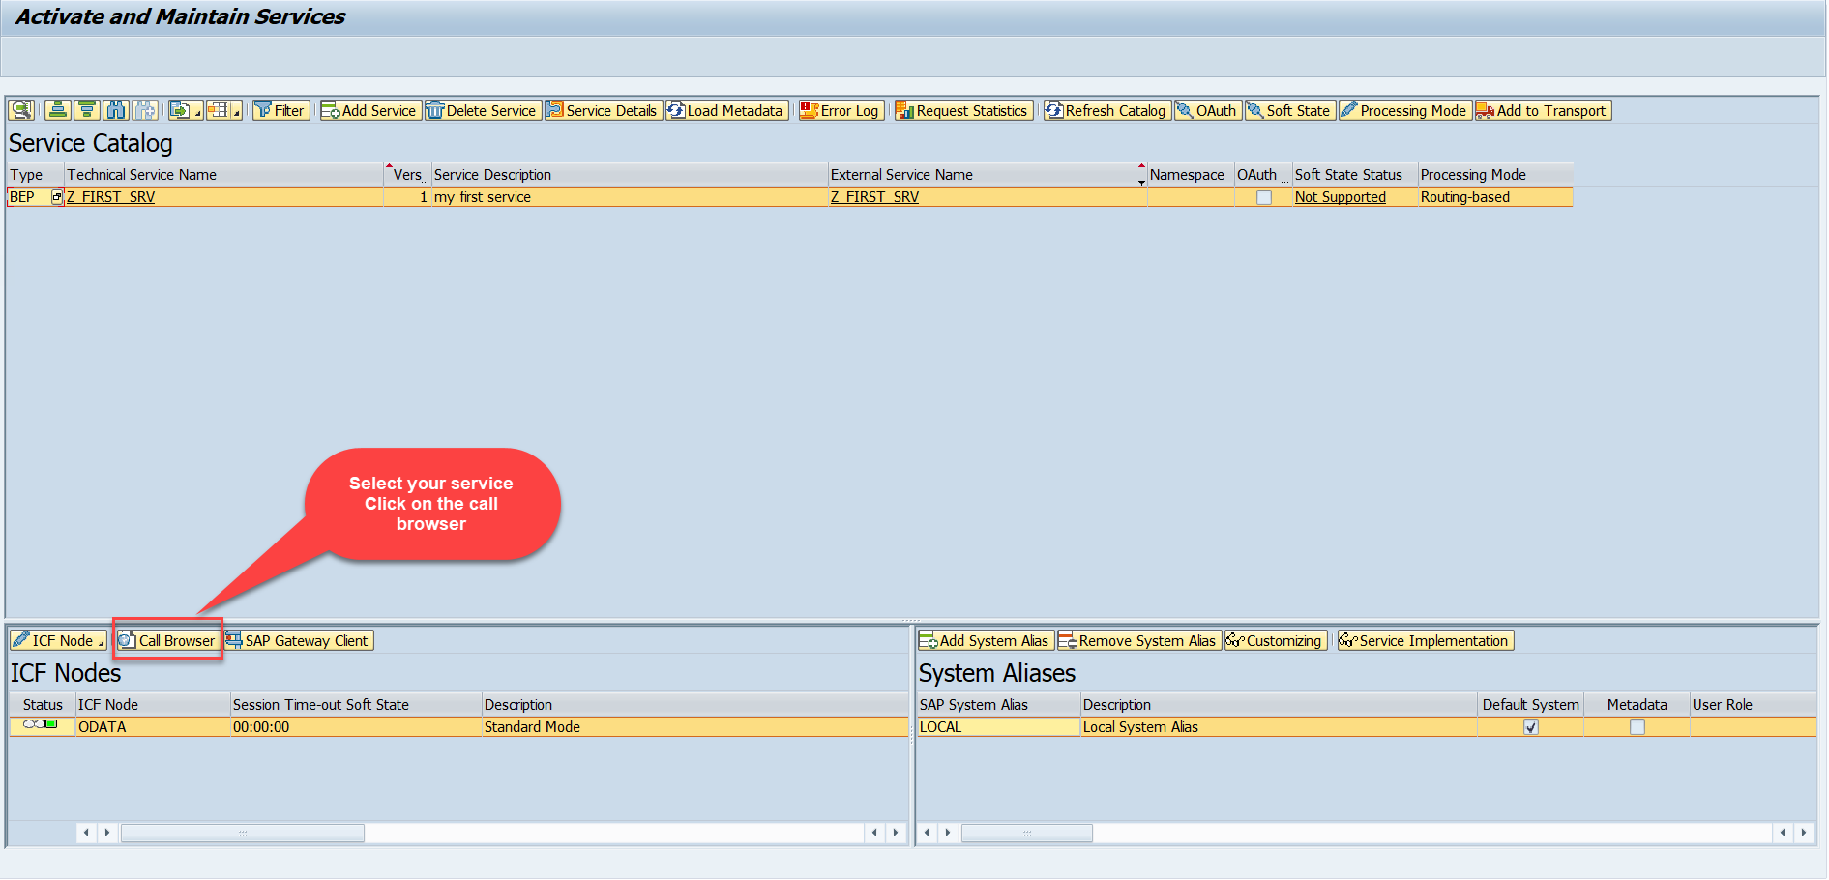
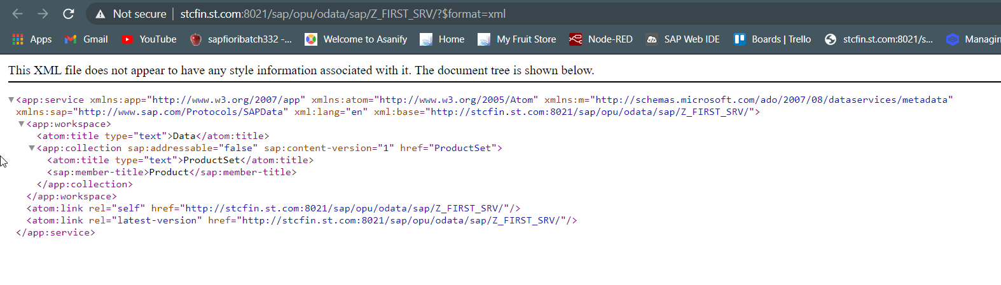
Building GetEntitySet Method
Step2: Call the service to the browser that we just created (go to service maintain (/iwfnd/maint_service))
Service in Browser

Slide 21
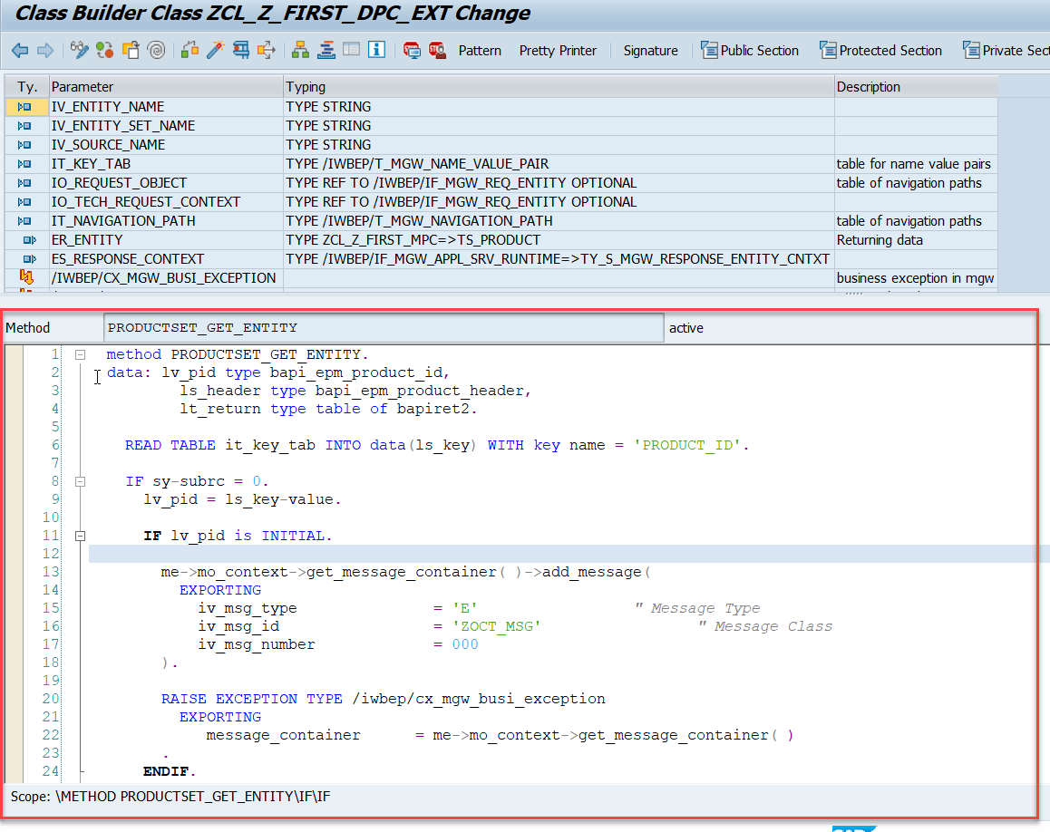
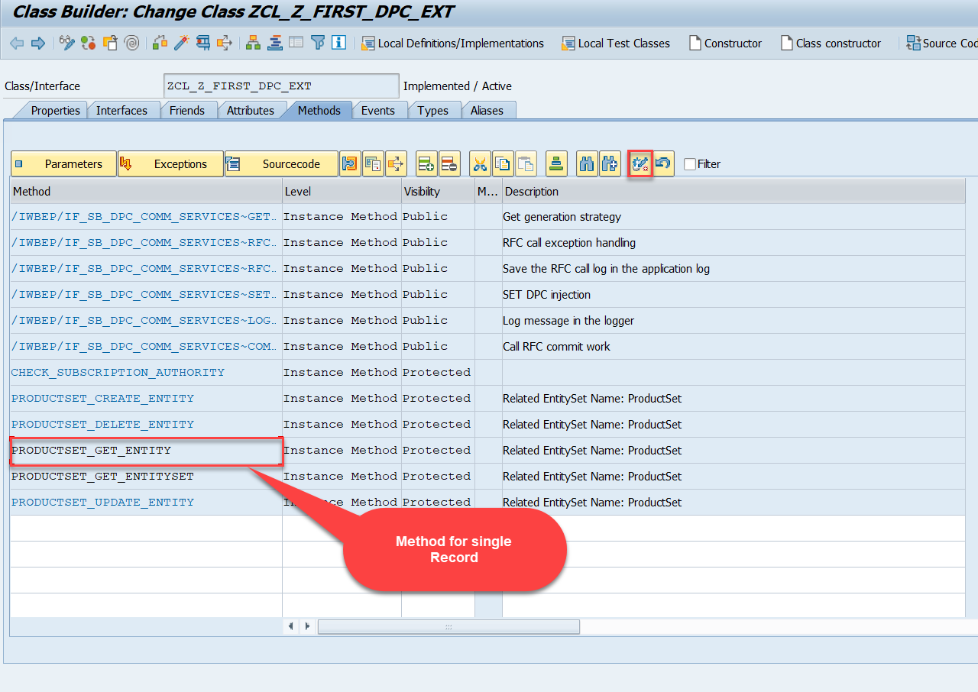
Building GetEntity(Single Record) Method
Go to DPC Extension of over service and redefine the method PRODUCTSET_GET_ENTITY

Slide 22
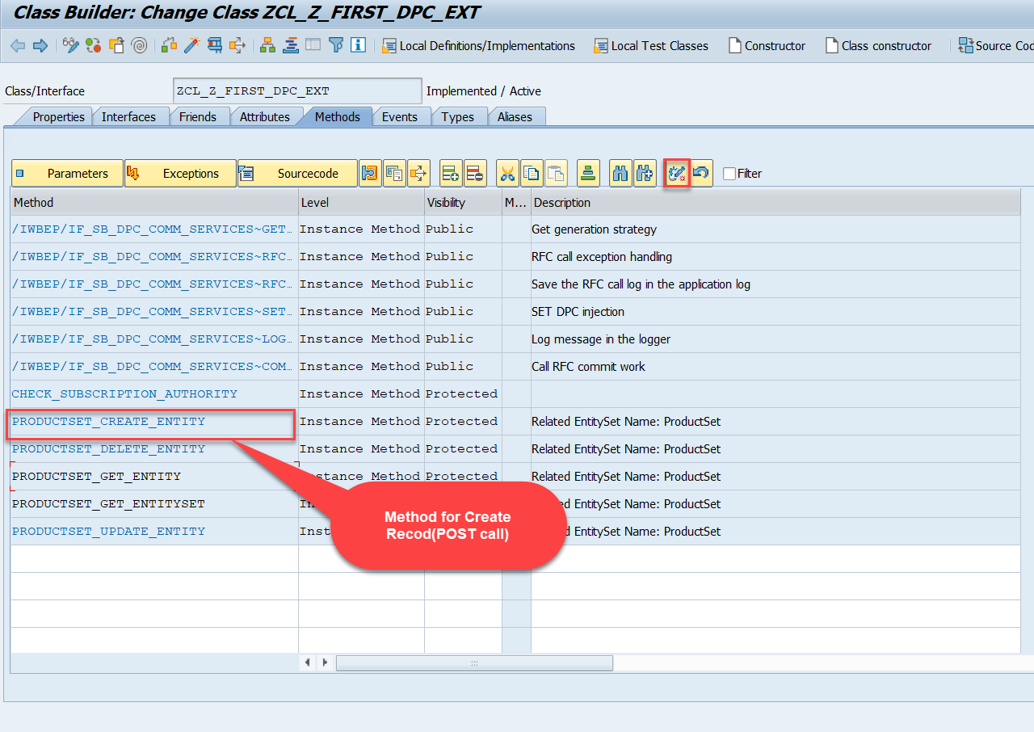
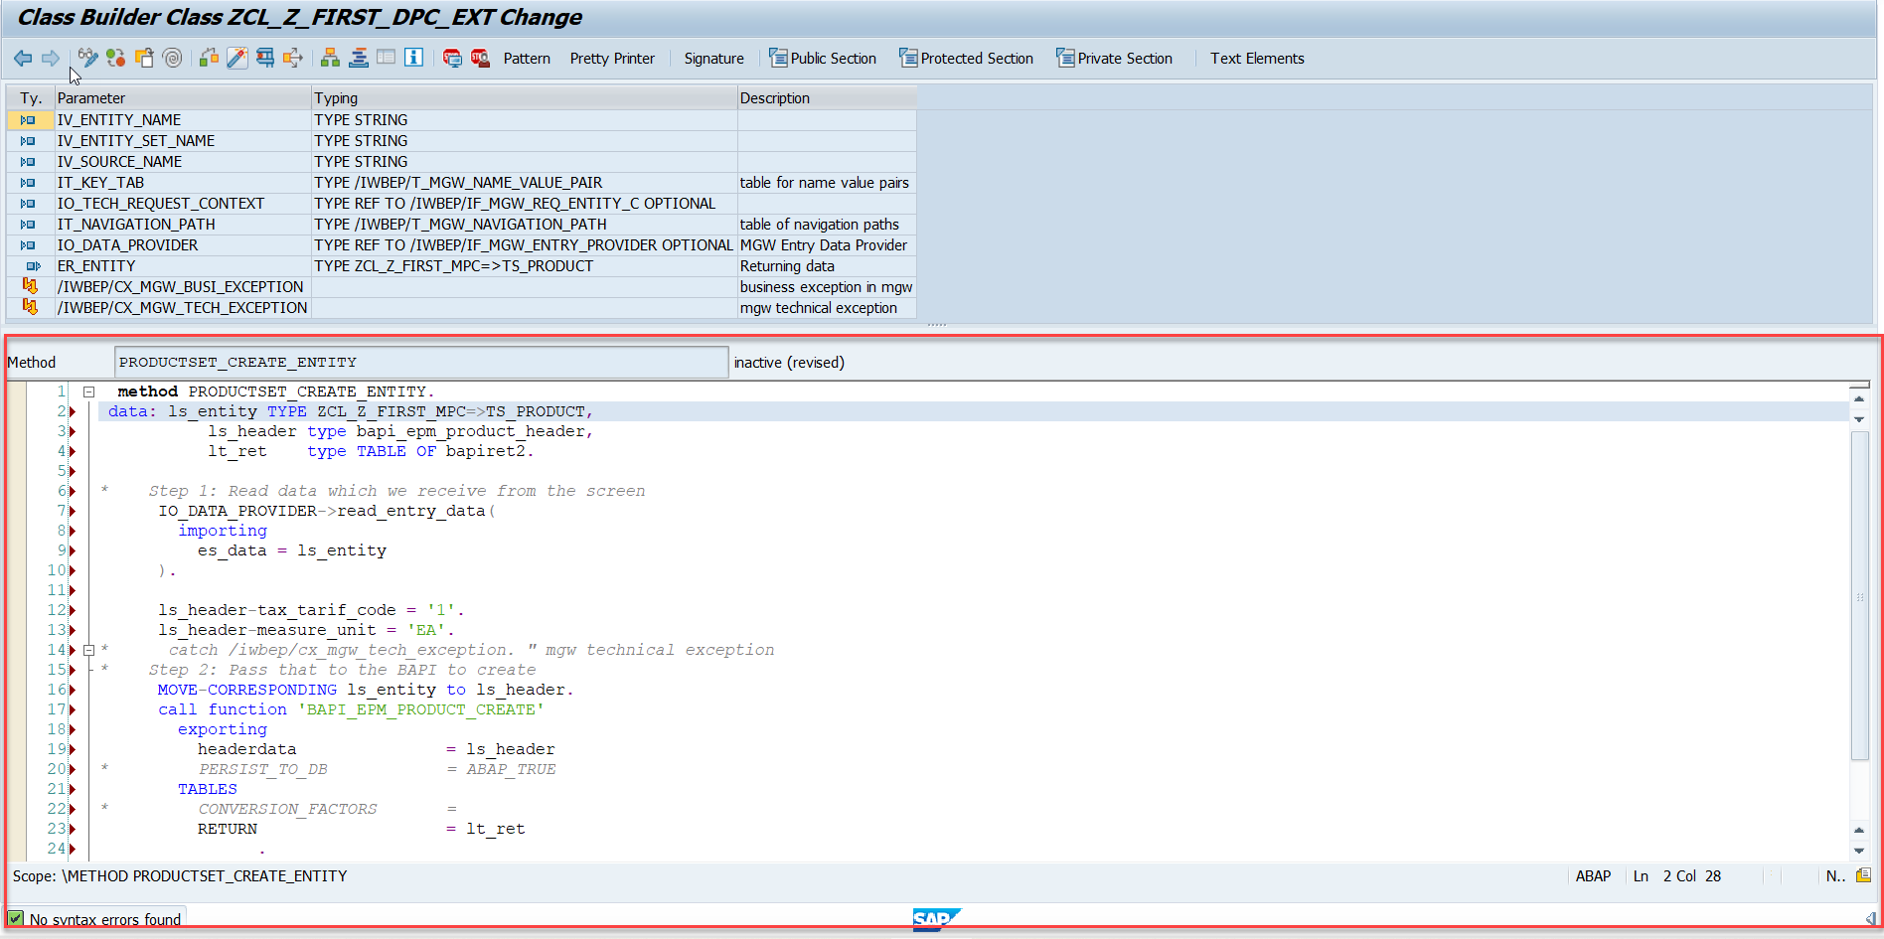
Building CreateEntity(POST) Method
Go to DPC Extension of over service and redefine the method PRODUCTSET_CREATE_ENTITY

Slide 23
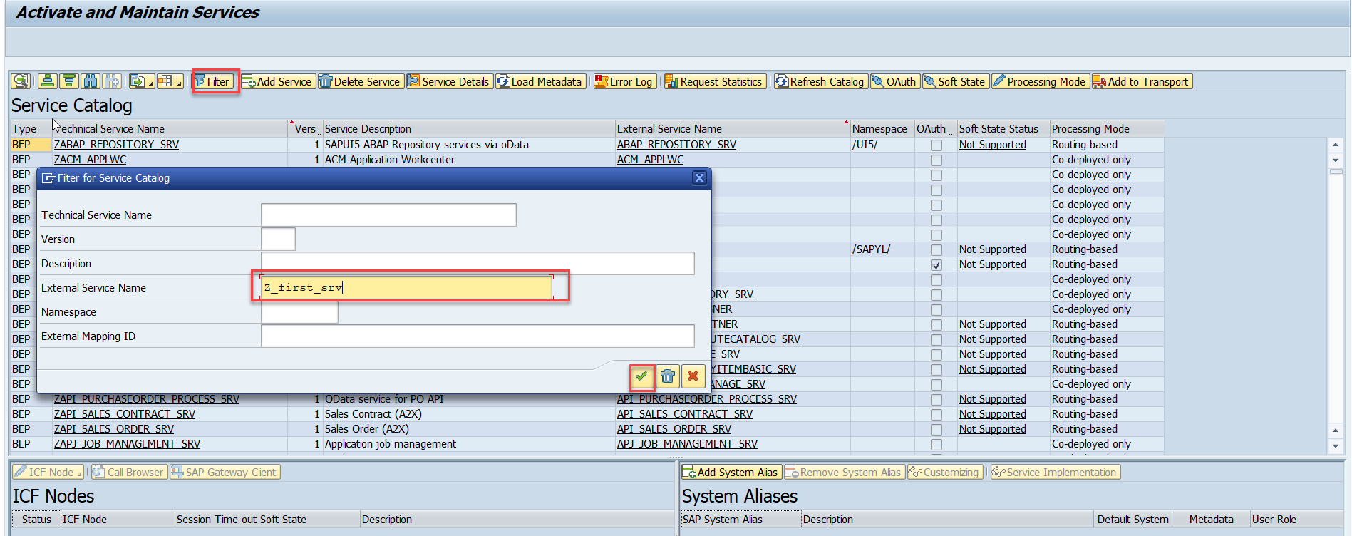
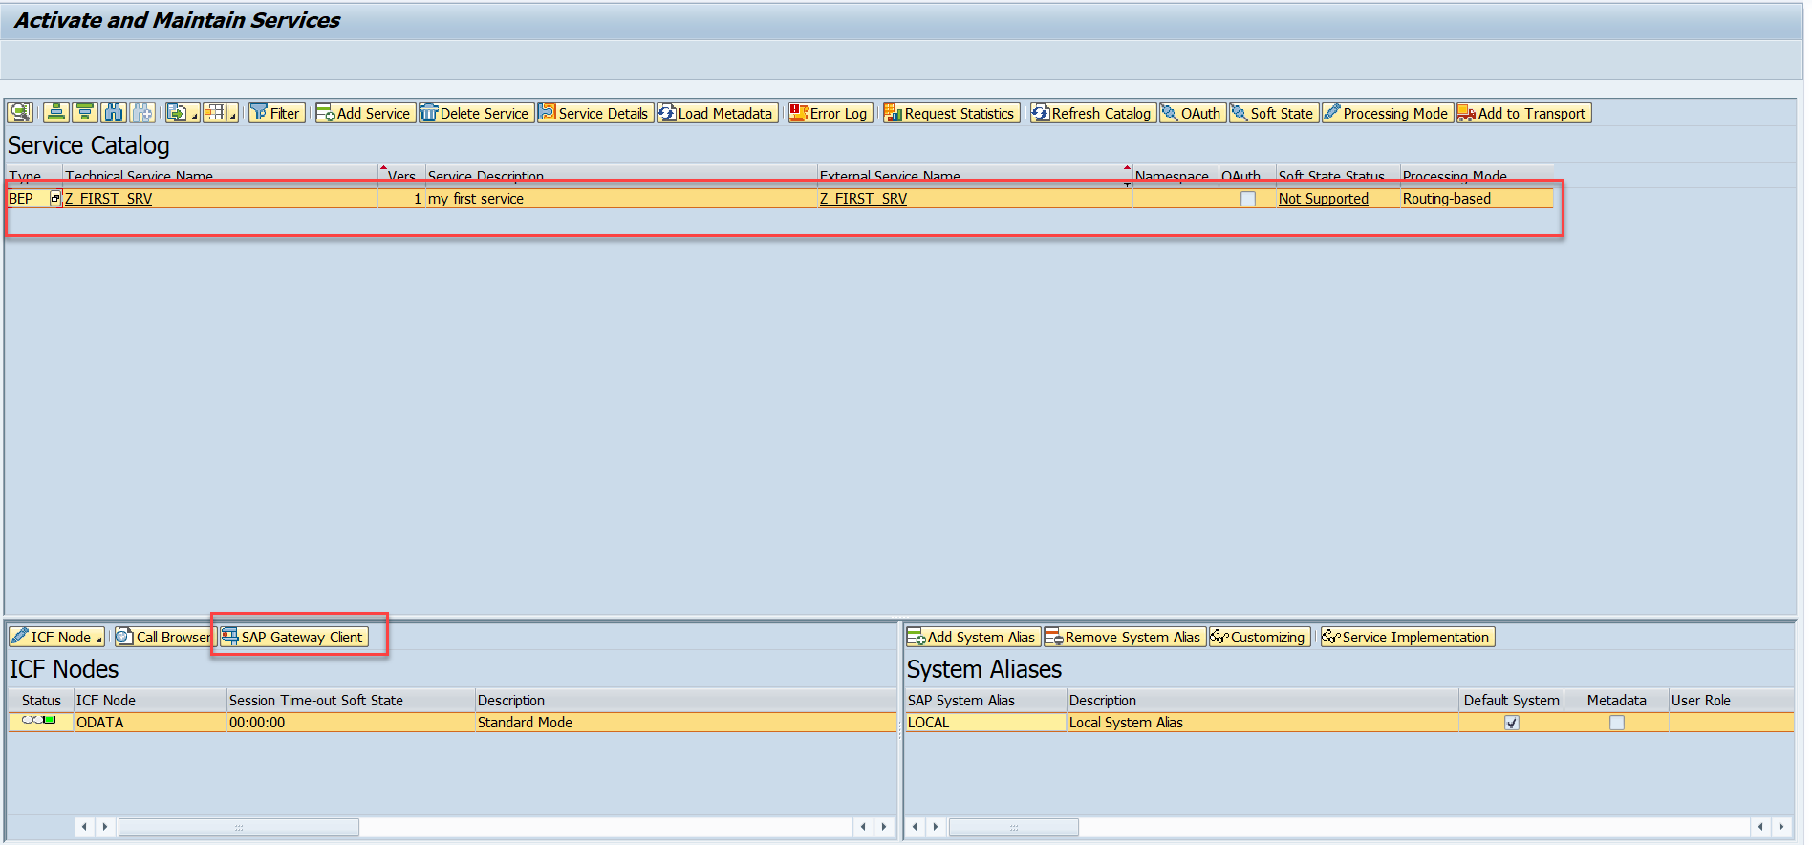
Testing the Create Method at Sap Gateway client
Step:1 Go to sap service maintance(tcode- /iwfnd/maint_service) and search for the service and then select the service and click on the sap gateway client

Slide 24
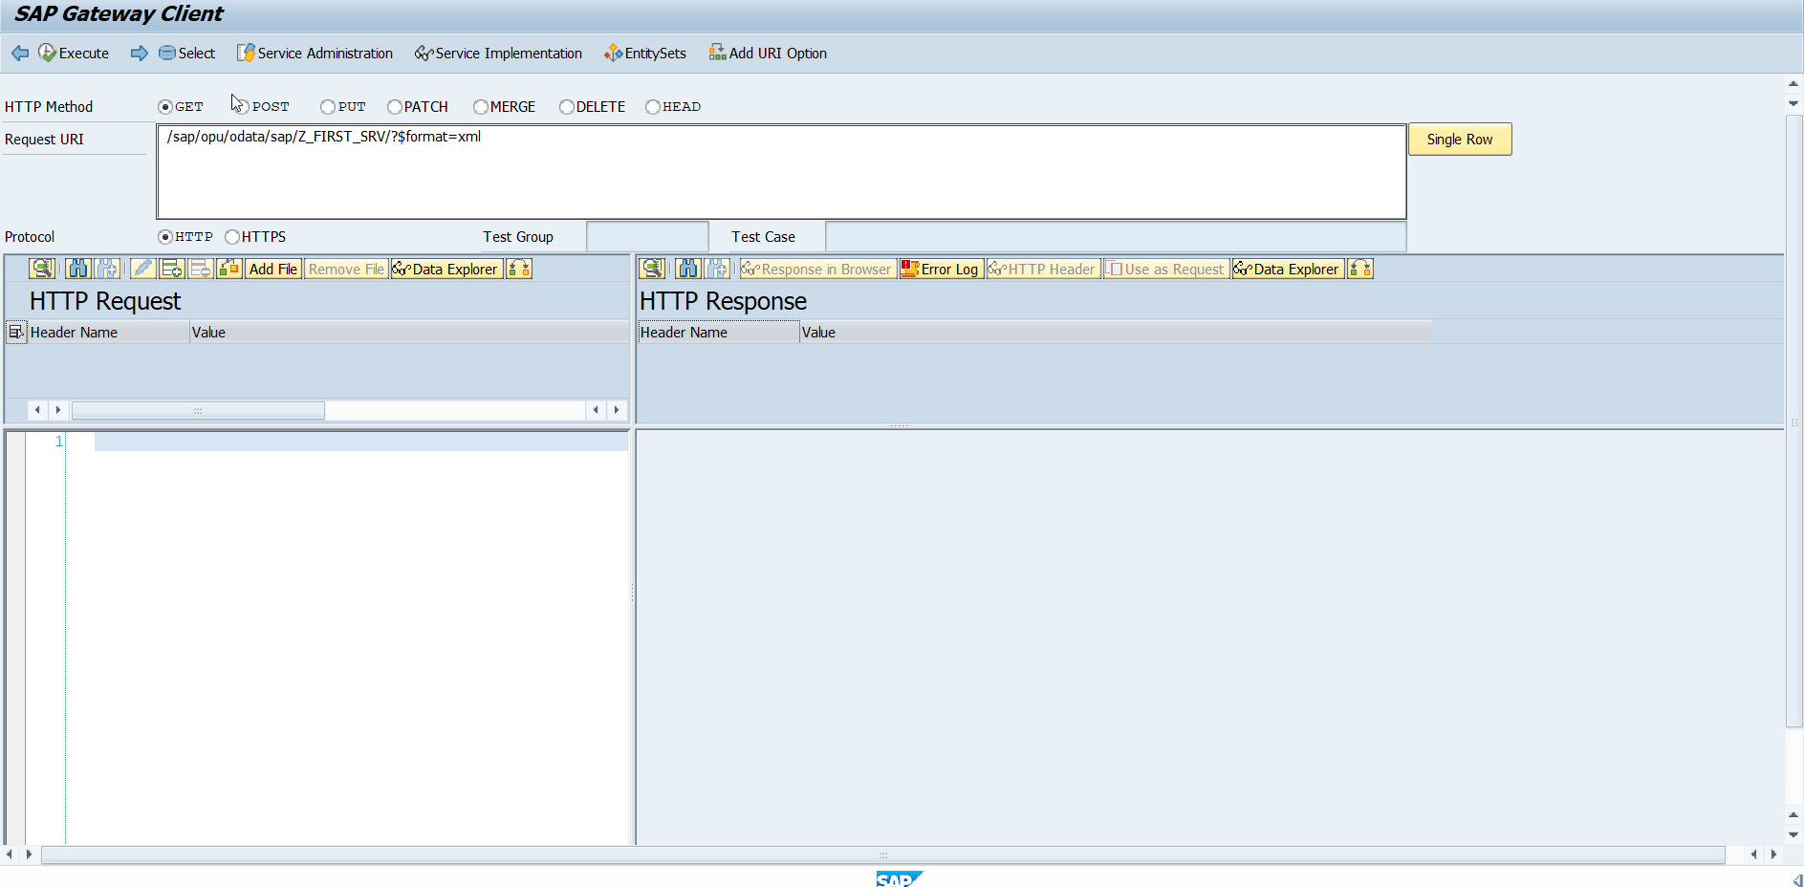
Testing the Create Method at Sap Gateway client
Step:2 Go to sap service maintance(tcode- /iwfnd/maint_service) and search for the service and then select the service and click on the sap gateway client

Slide 25
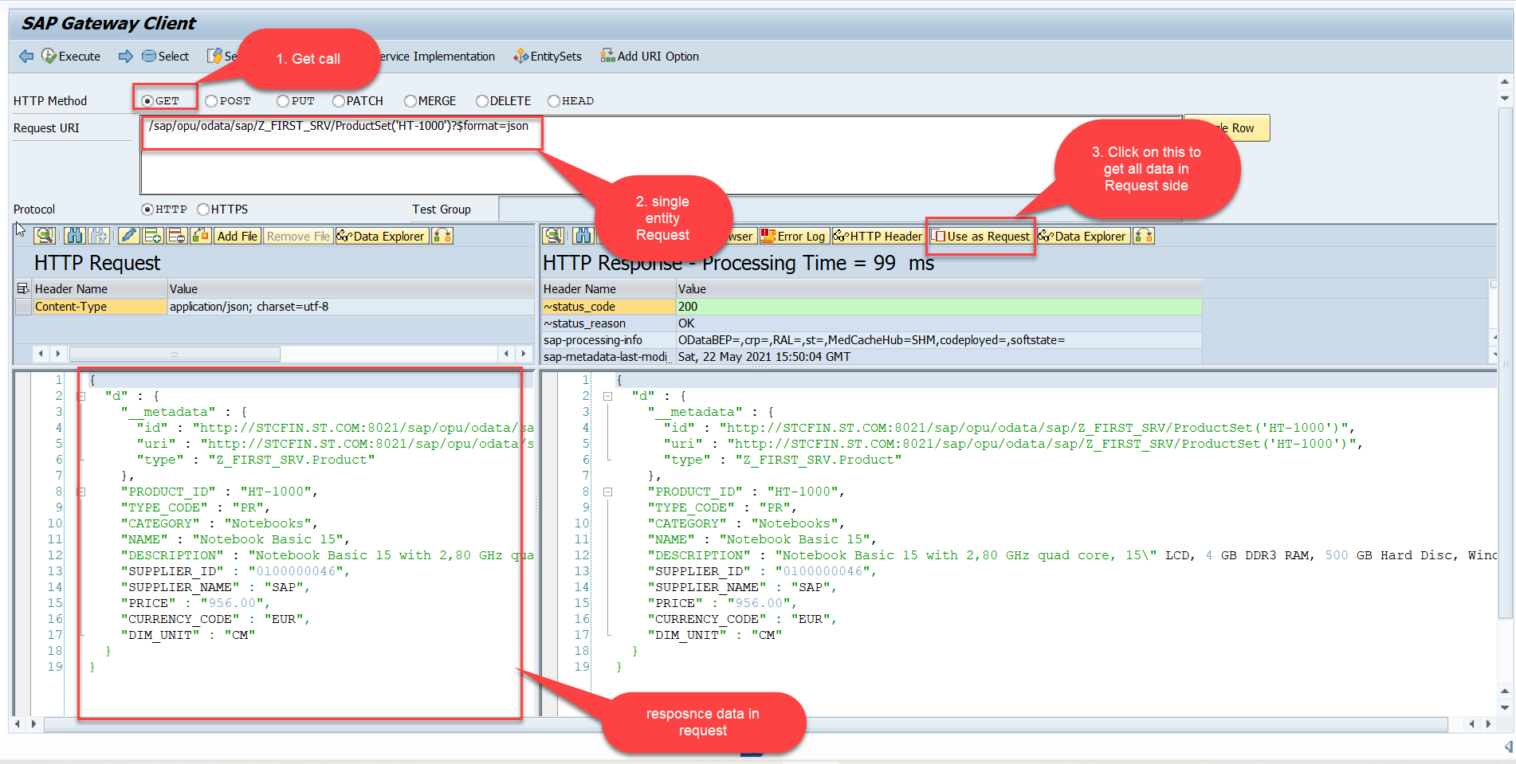
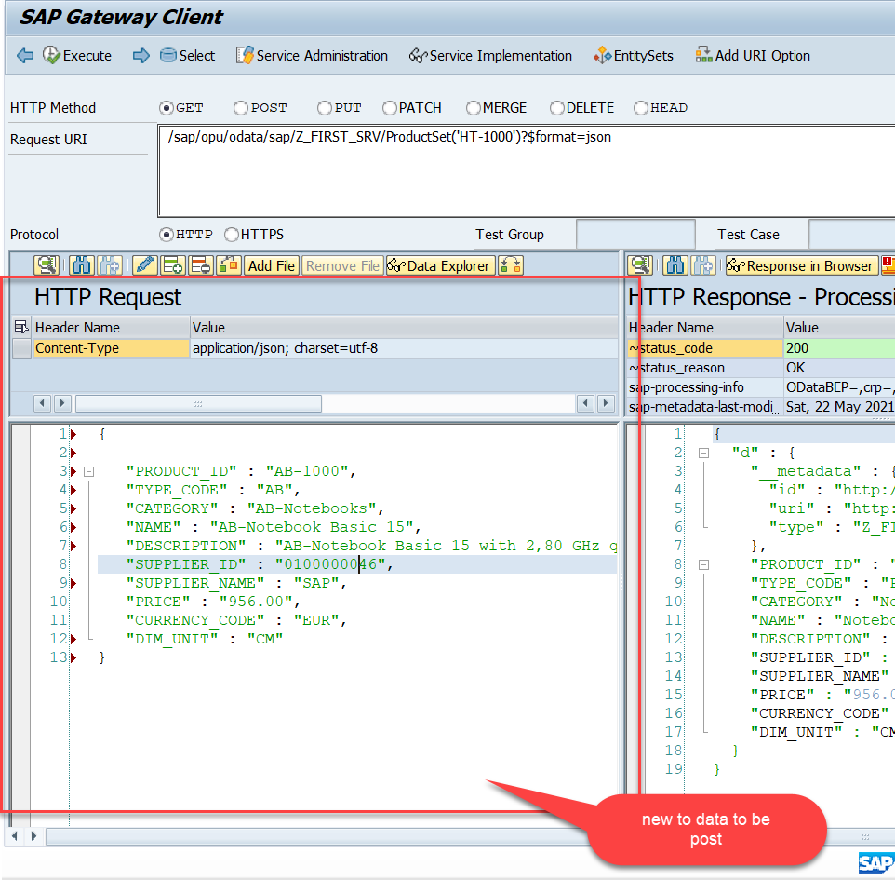
Testing the Create Method at Sap Gateway client
Step:3 Perform a getEntity in the Product set to get the payload to post (/sap/opu/odata/sap/Z_FIRST_SRV/ProductSet('HT-1000')?$format=json) and then clean the data and modify the payload as new.

Slide 26
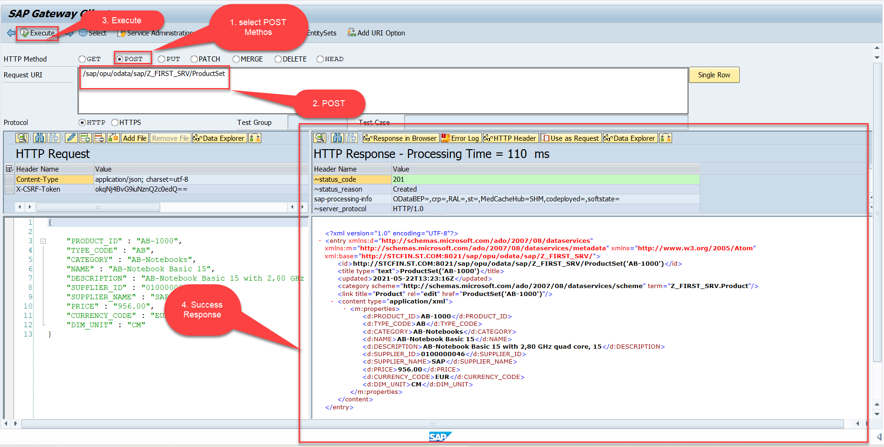
Testing the Create Method at Sap Gateway client
Step:4 send the post request at (/sap/opu/odata/sap/Z_FIRST_SRV/ProductSet)
You can check the saved data in database table (tcode – se11)

Slide 27
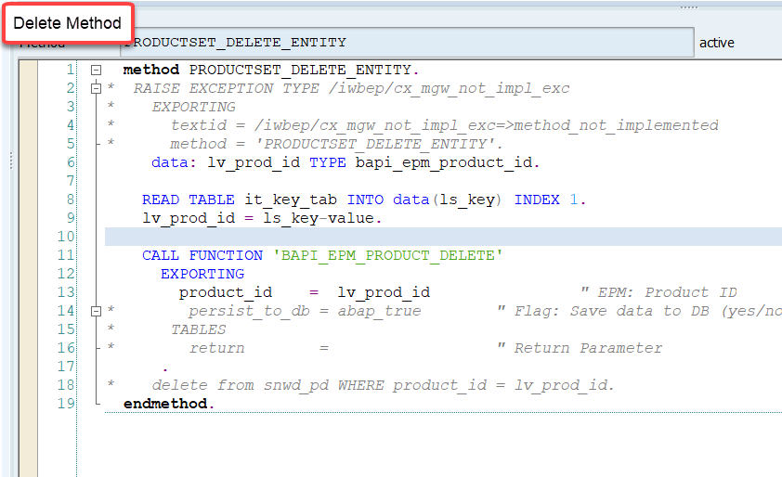
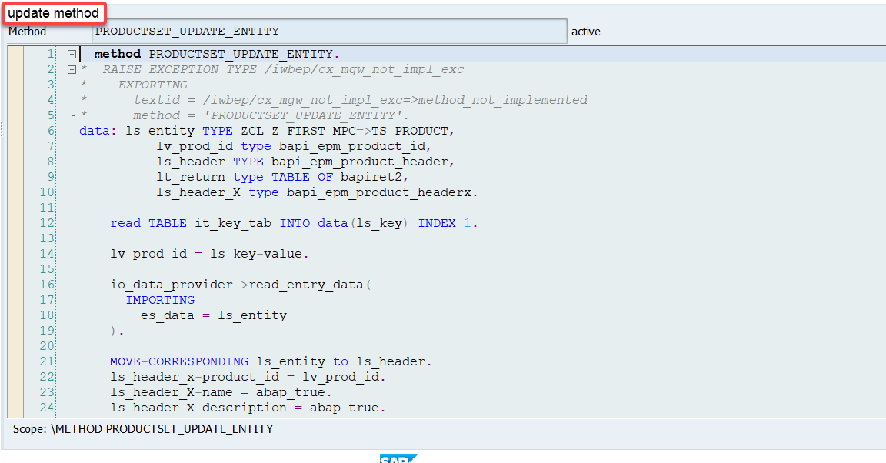
Implementing the delete and update method
We can implement the delete and update method in the cross-ponding dpc extension classes

Slide 28
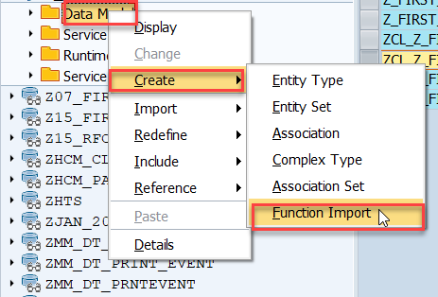
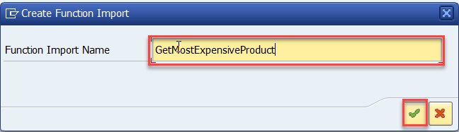
Function Import
At times, we need to implement the logic inside of OData which is not a direct CRUD operation e.g. calling a workflow, calling a BAPI which does some processing, Sending request to another server and can be invoked by the HTTP methods GET or POST .
For example: we can create the function import to GetMostExpensiveProduct in our Product set by the Category.
Step1: Right click the Data Model folder, and select Create and then select Function Import. Create Function Import dialog opens

Slide 29
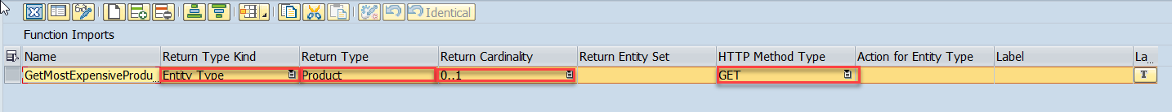
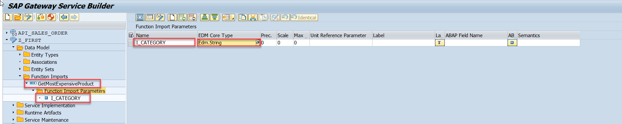
Function Import
Step2: Enter return type kind, return type, return cardinality & HTTP method Type
Step3: Giving function import parameters (I_CATEGORY)

Slide 30
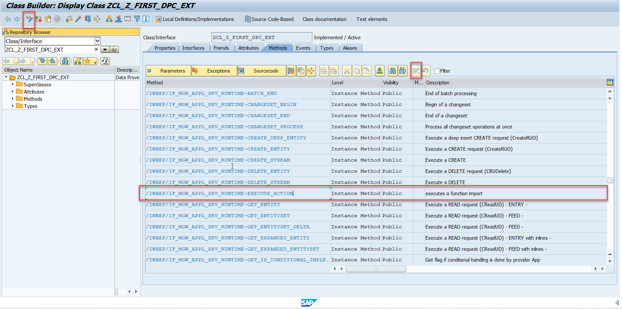
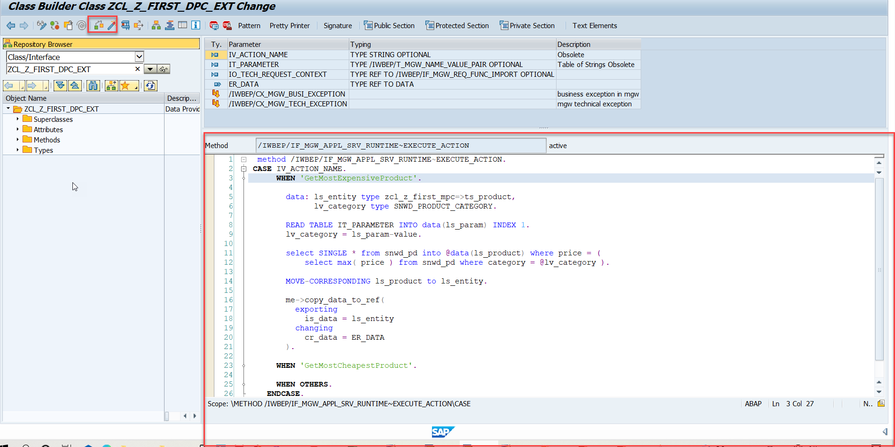
Function Import
Step4: Go to DPC Extension and search for the method--/IWBEP/IF_MGW_APPL_SRV_RUNTIME~EXECUTE_ACTION and redefine the class method

Slide 31

End of Day 7

Slide 32

Questions

Slide 33

Anubhav Oberoy

Slide 34


We’re committed to empower you to be
Most Desirable Resource
through powerful training solutions.
We build the workforce of the future.
250+
Corporate Clients
30,000+
Learners Trained
25000+
Learners Placed
FREE WEBINARS
Sign up for free webinars with industry experts every fortnight!
Enroll Now!
Contact us today!
https://anubhavtrainings.com/

Slide 35




More from AnubhavTrainings.com

Slide 36
Title
Content

